Slide 1
Critical Incident Summary 19th May’25(Monday) – 26th May’25(Monday)

Slide 2
CDP - Backends Contract Event Mismatch :
INCIDENT DETAILS
Alert Timing | NA | Created/Reported | 19st May’25 07:35 CET | Acknowledged | 19st May’25 07:35 CET | Resolved
Impact Duration | 19st May’25 07:35 CET - 24th May | Reported by | Touchpoint Enabler Team
Impact Duration | 15 May’24 18:51 – 19:47 |  |  |  |  | Resolved by
Impact | Some contracts are missing in channels (OneX , mmkc,) DE(0.093% mobile) & (1.2% Fixed) |  |  | Natco’s Impacted | NatCo(DE)
Summary | Impact Analysis: VBKZ-based Merge Logic in CDP CDP Logic Before April 2025: CDP created a permanent CDP ID for convergent customers based on iKDB matching quality alone. VBKZ value was not considered in merge decision. Business Requirement Introduced: CDP should only merge customers if: iKDB matching quality is 100%, and VBKZ values match in Carmen and CRM-T. Also mandated: reconciliation of historical customer merges using this new logic. Post-Implementation Issue: Customers reported missing contracts from different channels (MMA, MMKC, Oneshop). Escalations indicated incomplete customer views across systems. Root Cause Identified: Carmen backend team found that ~200K customers had incorrect VBKZ values. This caused valid customer relationships to break under new merge logic. Interim Fix: Carmen team set incorrect VBKZ values to NULL for the impacted customers. CDP Reconciliation Impact: CDP now needs to reprocess ~200K impacted customer records As per current logic, NULL VBKZ is treated as a private customer, CDP must clean up and correct these profiles to ensure: Accurate customer identity representation. Proper visibility of contracts across all channels.

Slide 3
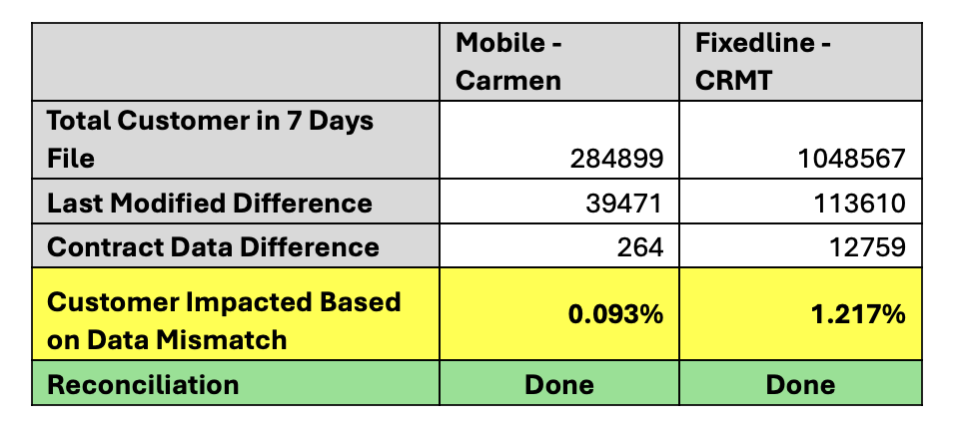
CDP - Backends Contract Event Mismatch :
INCIDENT DETAILS
Summary | 23rd May Problem #1: Mobile Contract Mismatch 264 Mobile IDs found with contract data mismatches in CDP. Reconciliation completed using 7-day Carmen Event file. Issue suspected for customers with >49 contracts. Support needed from Carmen Team (sample IDs attached). 24th May Problem #2: Fixedline Contract Mismatch 12,597 Fixedline IDs found with mismatches in CDP. Reconciliation completed using 7-day CRMT Event file. Suspected missing events in CDP — support needed from CRMT Team. Problem #3: Carmen VBKZ Correction in CDP Part 1 – Single-leg (No Match) 135,676 customers No contract mismatch; only VBKZ corrected ✅ Reconciled Part 2 – Single-leg (Potential Match) 42,457 customers Affected due to VBKZ functionality change Potential iKDB match ✅ Reconciled Part 3 – Convergent Customers 22,380 customers DOT-95566 May still be impacted ⚠️ Discussion pending with Business Team 26th May As per LIM call discussion, reconciliation between Carmen and CRM-T for the initial load is not required. CDP has shared the list of mismatched customers, and Carmen/CRM-T teams will investigate the reason for missing events on their end. Next call is schedule for next week. For part 3 of VBKZ CDP need to implement DOT-95566

Slide 4
Thank You..!!

